Slide 1

Select Data Analytics Tools for Crowe
Microsoft Power BI
Presented by
Theerapat Rojkanok
Why Microsoft Power BI?
-Convenient and Flexible
-Easier generating visualization
-Early adopter in Augmented Analysis
-Obtain much interesting by other audit firms
-Price is varied

Slide 2
Query Editor: allows data preparation within Power BI
1. Cleaning data
-Remove outliers
-Filling in and/or remove missing value
-Standardized data format
2. Transforming and enriching data
-Adjust data type
-Categorize related data
Convenient and Flexible

Slide 3
Query Editor: Interested Features
1. Basic Excel function
2. Append Queries
3. Merge Queries
4. Conditional column
5. Statistic
Convenient and Flexible

Slide 4
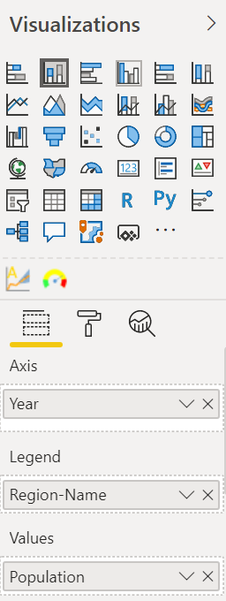
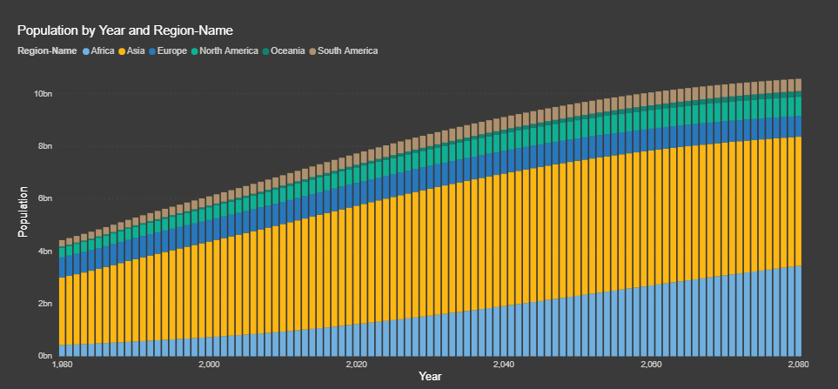
Report View
1. User-Friendly
2. Many kinds of visualization
3. Drag & Drop function
4. Filter function
5. Slicer
Easier generating visualization

Slide 5
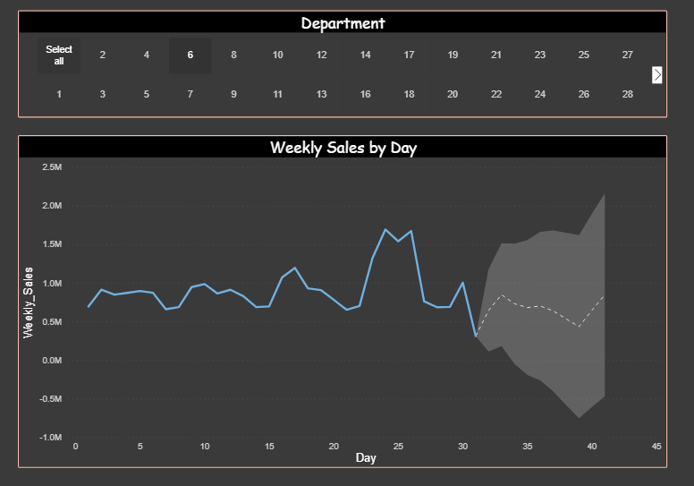
Augmented Analysis: Use Machine Learning to automated discover insight and sharing.
-Ex. Time-Series forecasting
Early adopter in Augmented Analysis

Slide 6
There are 3 version of Power BI
1. Power BI Desktop Free version
not allow to share with other
2. Power BI Pro $4.99 monthly
allow to collaborate and share with team on cloud
self-service in cloud
3. Power BI Premium $4995 monthly
enterprise version
cloud compute and storage resource on cloud
Price is varied

Slide 8
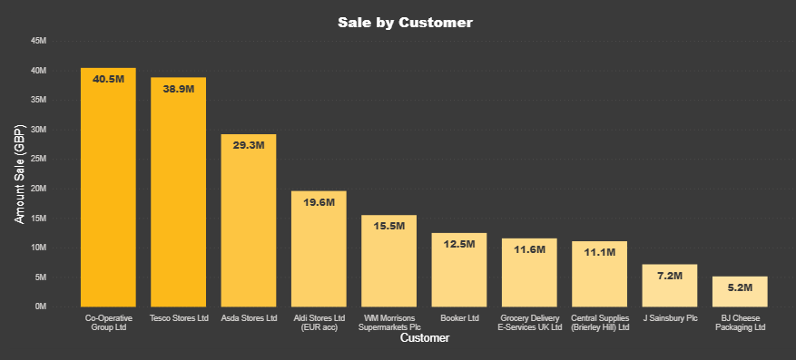


Slide 9
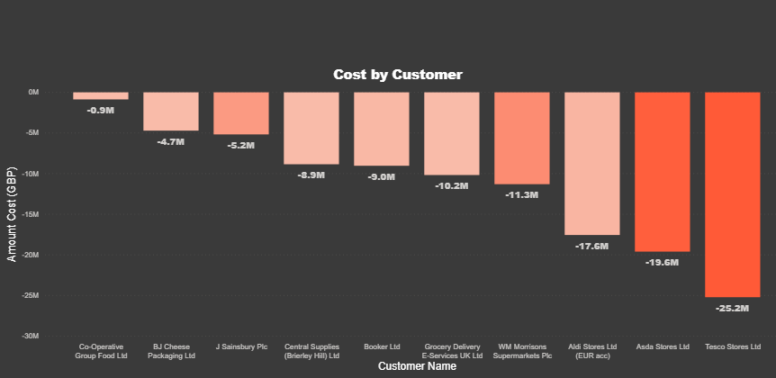

Slide 10
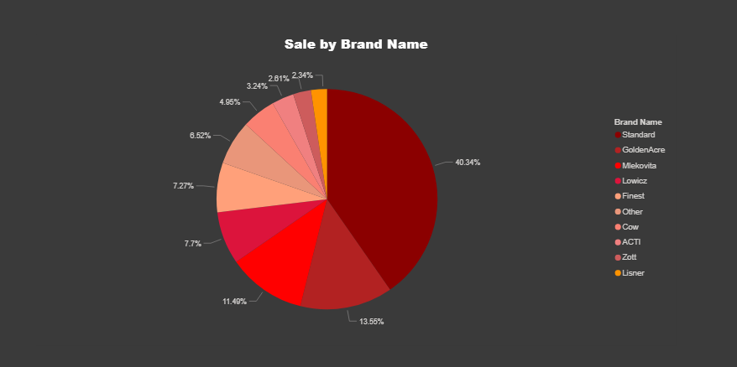

Slide 11
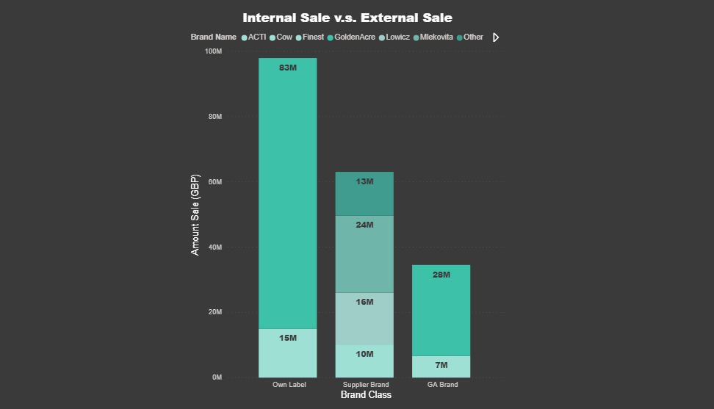

Slide 12
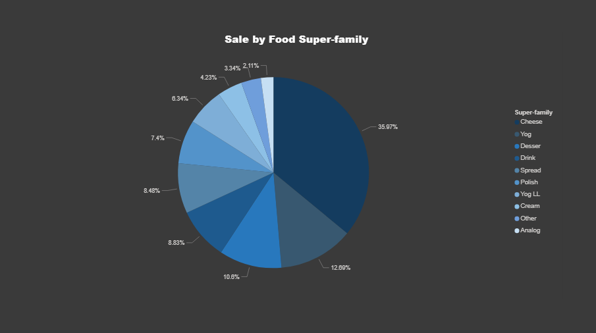

Slide 13
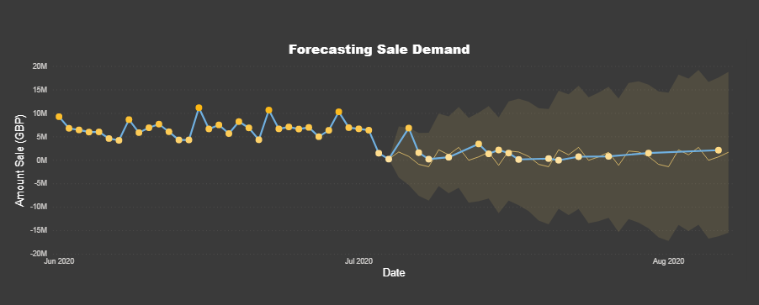

Slide 14
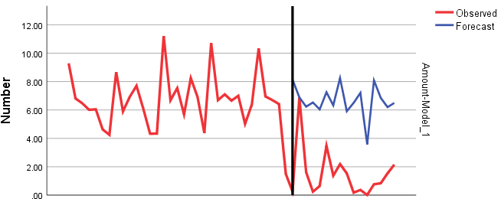

Slide 15
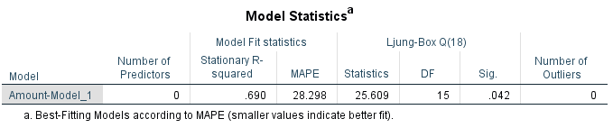
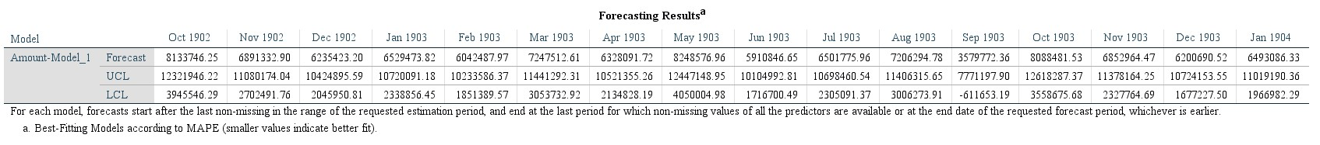

Slide 16
